Slide 1
Typing Speed Game using Python
By
Ravi Kumar Singh
Sharan Patil
Under the Guidance of
Dr. Shailaja

Slide 2
Abstract
The Typing Speed Game helps people in improving their typing speed in a fun way.
It improves the hand eye co-ordination.
Provides accuracy score and typing speed in words per minute(wpm)

Slide 3
Software Requirements
Python 3.x
Pygame
Windows/Linux OS
Any Python IDE

Slide 4
How it Works?
Files used:
Typing-speed-open.png
Backgroung.jpg
Sentences.txt
Game.py

Slide 5
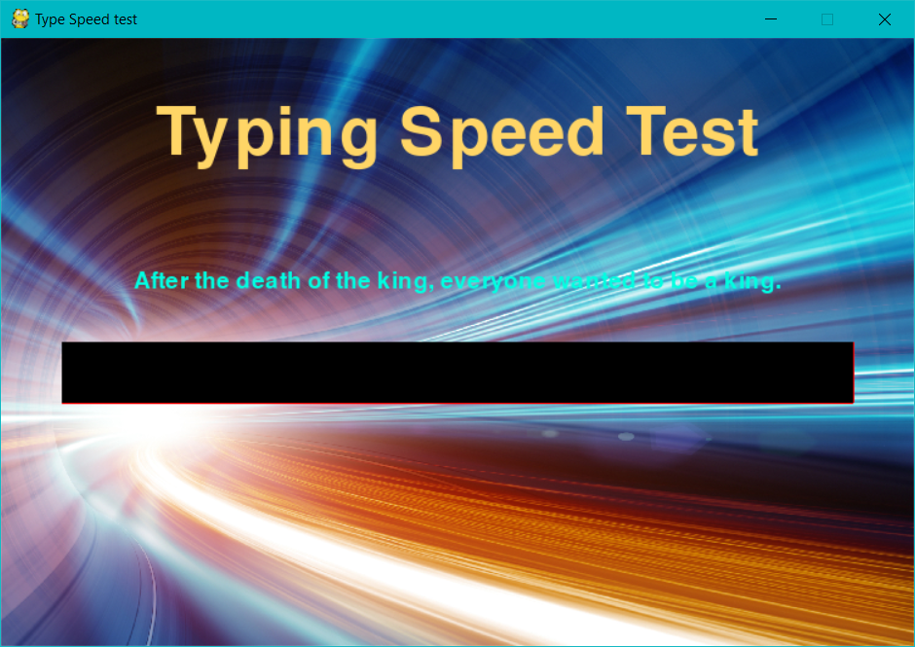
How it works?
Functions implemented:
draw_text()
get_sentence()
Show_result()
run()

Slide 6
Application
It helps in improving the typing speed of a person which comes with several benefits like
Save time:
It would help you to write your blogs, letters, answers, chatting etc. faster without wasting time.
Job:
Many jobs both in govt. and private sector ask for good typing speed.
Pleasure:
It is a pleasure to just focus on thinking and the typing is done automatically unlike others who don't know this skill.
Impression:
It will impress other people who don't know this skill. They may say like, Wow! how can you do that and within mind they may be thinking if they could also type like you. Imagine!
Lifetime with you:
Like bicycle, once you learn it, will be always with you.

